Slide 1
IV2: Shift-Share Instruments
UIUC ECON 474 Econometrics of Policy Evaluation

Slide 2
Overview
Next time: Read Ch 7.6 and 7.7.1
Today:
How to estimate supply elasticities
Shift-share instruments
Intuition
Applications
Coding: constructing shift-share instruments

Slide 3
Motivation
The labor market, industries, and occupations

Slide 4
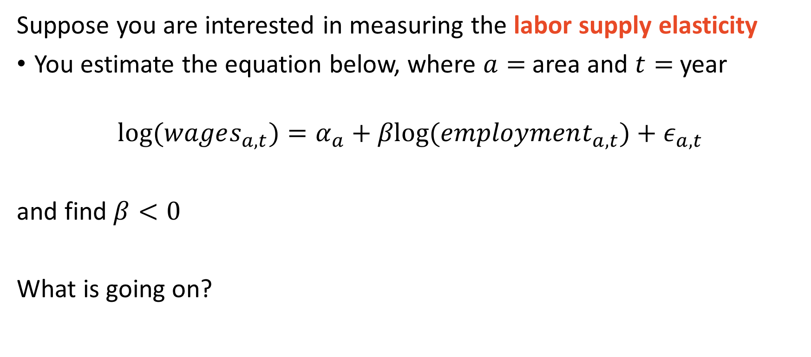
Estimating supply elasticities
Suppose you are interested in measuring the labor supply elasticity
You estimate the equation below, where $a=$area and $t=$year
$$log⁡(wages_{a,t})=α_{a}+βlog⁡(employment_{a,t})+ε_{a,t}$$
and find $β<0$
What is going on?

Slide 5
Prices and quantity data are equilibrium outcomes
D
S
Wages
S
D
S
D
Employment

Slide 6
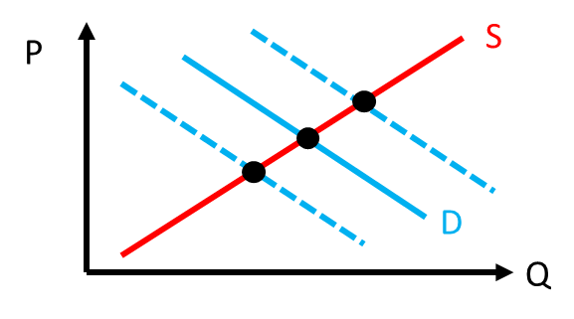
Bartik 1991 instrument intuition
Use shocks to
national product demand
(a labor demand shifter)
to “trace out” the labor supply curve
An aggregated data technique:
Obtain pre-analysis period local employment shares for each industry
Obtain current national industry employment shifts from last period
Use national shifts with initial shares to predict local industry growth

Slide 7
A quick note: industries vs occupations
Industries defined by products
Firm outputs
North American Industry Classification Codes (NAICS)
Ex) Cornerstone Research
NAICS6: 541618
“Other Mgmt Consulting Services”
NAICS4: 5416
“Mgmt, Sci, and Tech Cons. services”
NAICS2: 54
“Professional, Sci, and Tech services”
Occupations defined by worker tasks
Firm inputs
Standard Occupation Classification (SOC)
EX) Economist
SOC6: 19-3011
“Economist”
SOC4: 19-30
“Social scientists and related workers”
SOC2: 19
“Life, Physical, and Social Sci Occs”

Slide 8
Shift-share instruments
Tracing out curves with supply or demand shifters

Slide 9
Are shift-share instruments valid?
Random: “as good as randomly assigned”
Assumption: local markets are price takers in the national product market
National product market is exogenous to local labor markets
Inclusion restriction: “instrument predicts treatment”
“ECON 101” says yes, but we can test this nonetheless
Exclusion restriction: “IV predicts outcome only through treatment”
Product demand does not directly affect wages

Slide 10
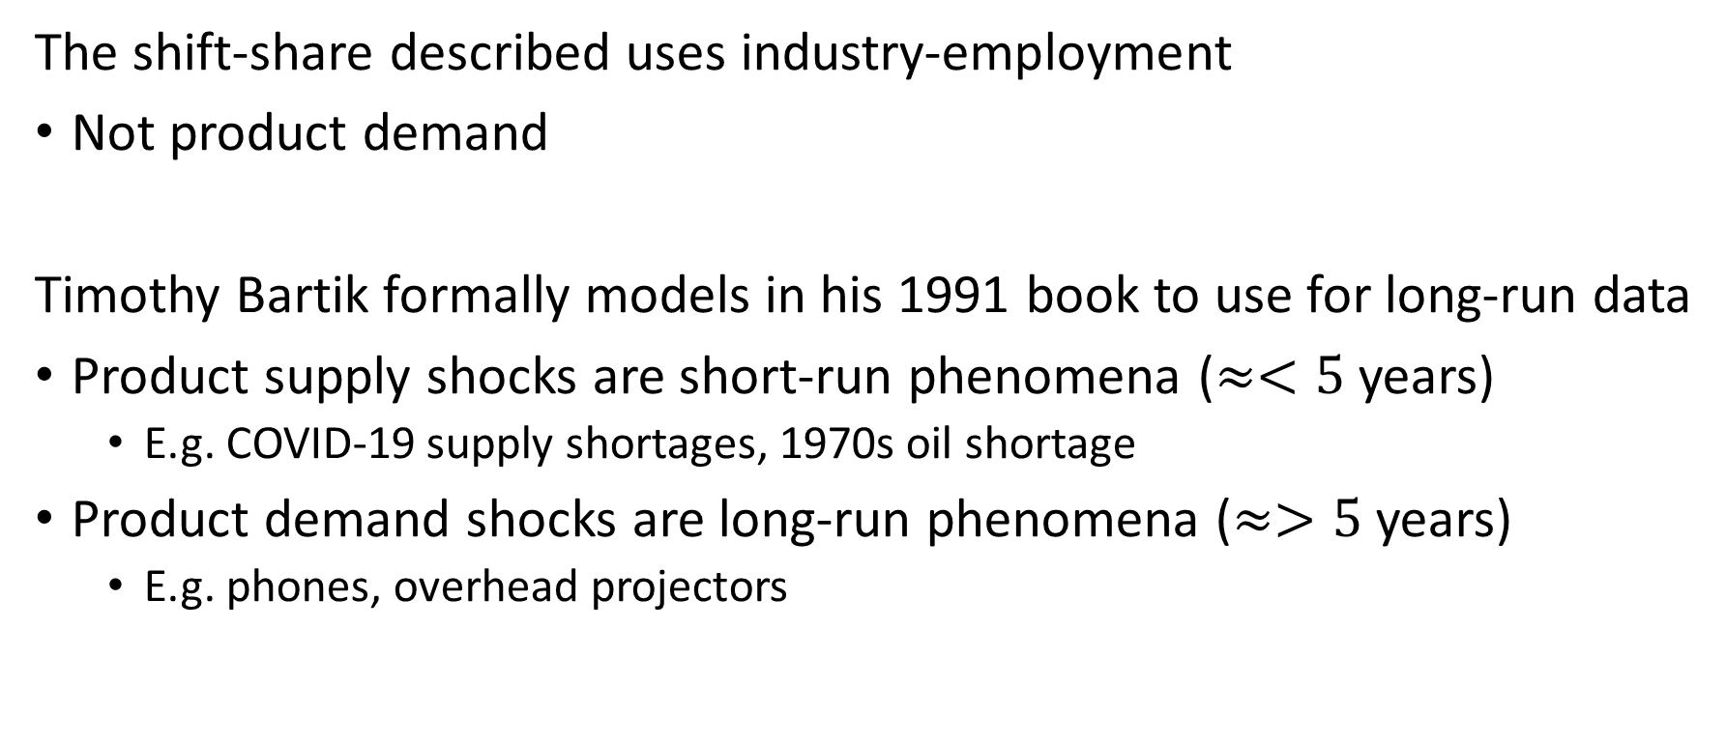
Caveats of shift-share instruments
The shift-share described uses industry-employment
Not product demand
Timothy Bartik formally models in his 1991 book to use for long-run data
Product supply shocks are short-run phenomena ($≈<5$ years)
E.g. COVID-19 supply shortages, 1970s oil shortage
Product demand shocks are long-run phenomena ($≈>5$ years)
E.g. phones, overhead projectors

Slide 11


This building will stay relevant forever: UWYO

Slide 12
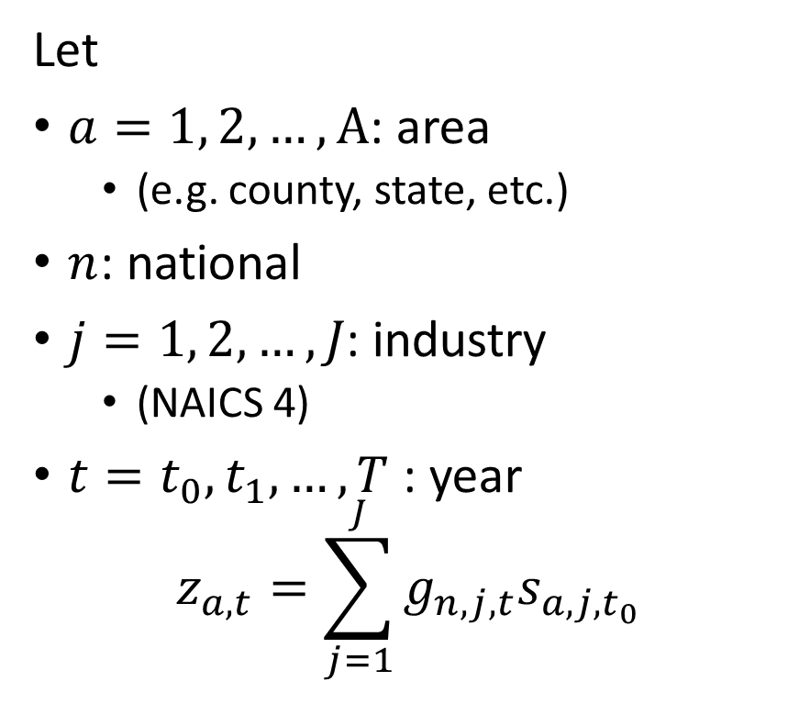
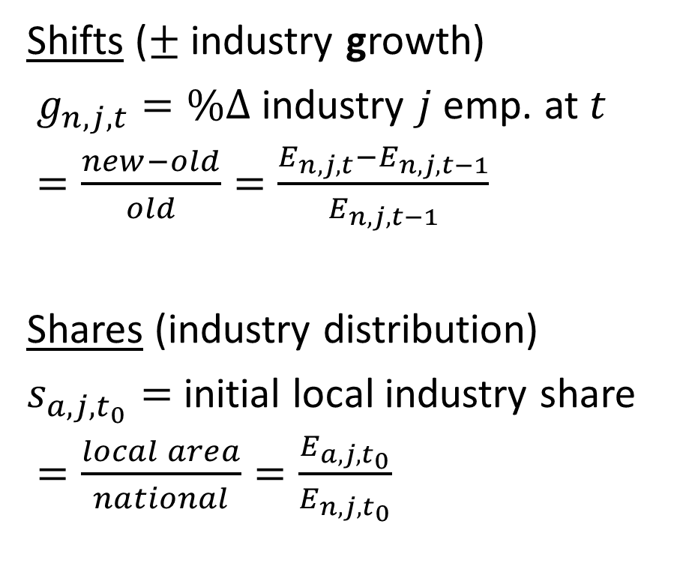
Creating shift-shares $z_{a,t}$ to predict $emp_{a,t}$ in 1st stage
Let
$a=1, 2, …, A$: area
(e.g. county, state, etc.)
$n$: national
$j=1, 2, …, J\text{:}$ industry
(NAICS 4)
$t=t_{0}, t_{1}, …, T$: year
$$z_{a,t}=\sum_{j=1}^{J}{g_{n,j,t}s_{a,j,t_{0}}}$$
Shifts ($±$ industry growth)
$g_{n,j,t}=\%Δ$ industry $j$ emp. at $t$
$=\frac{new−old}{old}=\frac{E_{n,j,t}−E_{n,j,t−1}}{E_{n,j,t−1}}$
Shares (industry distribution)
$s_{a,j,t_{0}}=$ initial local industry share
$=\frac{local area}{national}=\frac{E_{a,j,t_{0}}}{E_{n,j,t_{0}}}$

Slide 13




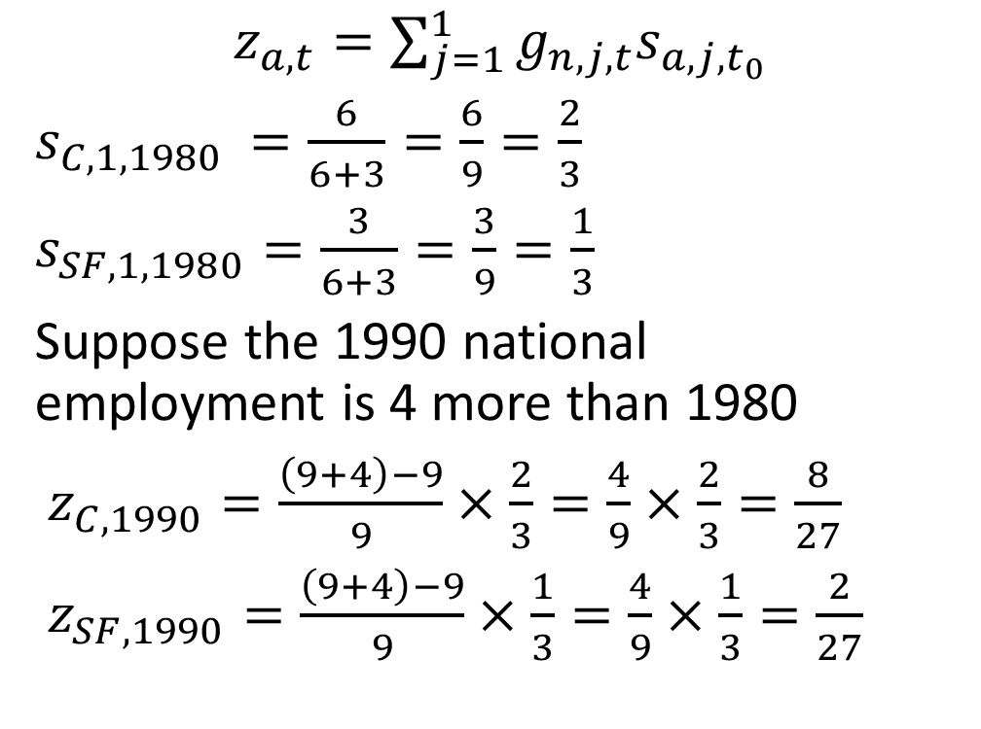
A simple 2 region $×$ 1 industry example
Chicago Employed at $t_{0}=1980$
San Francisco
$z_{a,t}=\sum_{j=1}^{1}{g_{n,j,t}s_{a,j,t_{0}}}$
$s_{C,1,1980 }=\frac{6}{6+3}=\frac{6}{9}=\frac{2}{3}$
$s_{SF,1,1980}=\frac{3}{6+3}=\frac{3}{9}=\frac{1}{3}$
Suppose the 1990 national employment is 4 more than 1980
$z_{C,1990}=\frac{\left(9+4\right)−9}{9}×\frac{2}{3}=\frac{4}{9}×\frac{2}{3}=\frac{8}{27}$
$z_{SF,1990}=\frac{\left(9+4\right)−9}{9}×\frac{1}{3}=\frac{4}{9}×\frac{1}{3}=\frac{2}{27}$

Slide 14

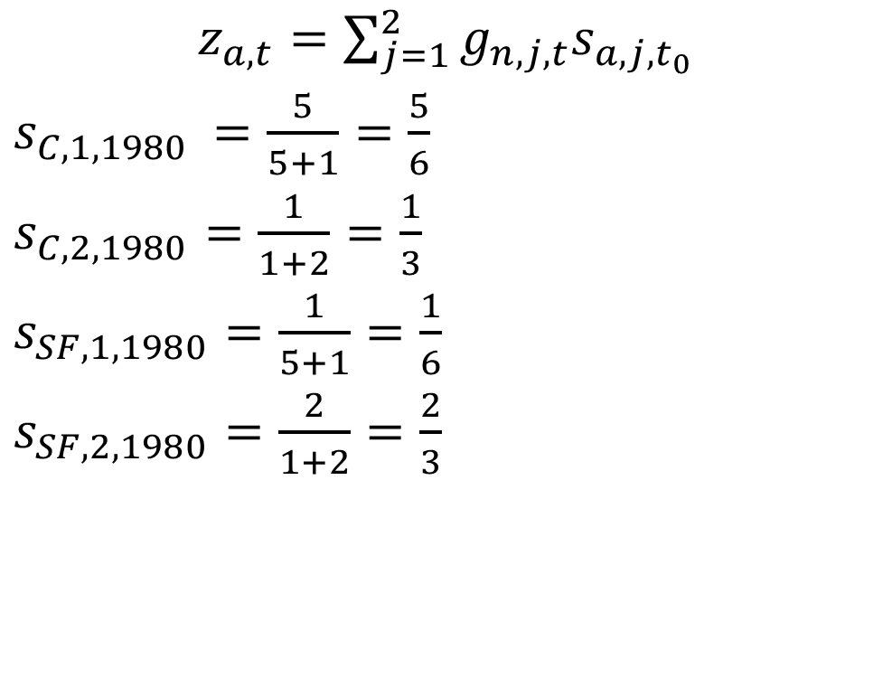
A 2 region $×$ 2 industry example
Chicago Employed at $t_{0}=1980$
San Francisco
$z_{a,t}=\sum_{j=1}^{2}{g_{n,j,t}s_{a,j,t_{0}}}$
$s_{C,1,1980 }=\frac{5}{5+1}=\frac{5}{6}$
$s_{C,2,1980}=\frac{1}{1+2}=\frac{1}{3}$
$s_{SF,1,1980}=\frac{1}{5+1}=\frac{1}{6}$
$s_{SF,2,1980}=\frac{2}{1+2}=\frac{2}{3}$

Slide 15
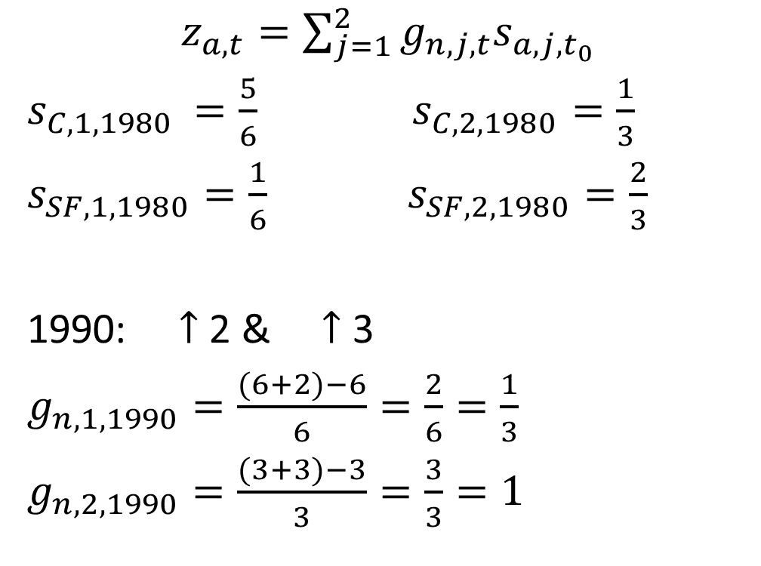
A 2 region $×$ 2 industry example
Chicago Employed at $t_{0}=1980$
San Francisco
$z_{a,t}=\sum_{j=1}^{2}{g_{n,j,t}s_{a,j,t_{0}}}$
$s_{C,1,1980 }=\frac{5}{6}$ $s_{C,2,1980}=\frac{1}{3}$
$s_{SF,1,1980}=\frac{1}{6}$ $s_{SF,2,1980}=\frac{2}{3}$
1990: $↑$ 2 & $↑$ 3
$g_{n,1,1990}=\frac{(6+2)−6}{6}=\frac{2}{6}=\frac{1}{3}$
$g_{n,2,1990}=\frac{(3+3)−3}{3}=\frac{3}{3}=1$

Slide 16
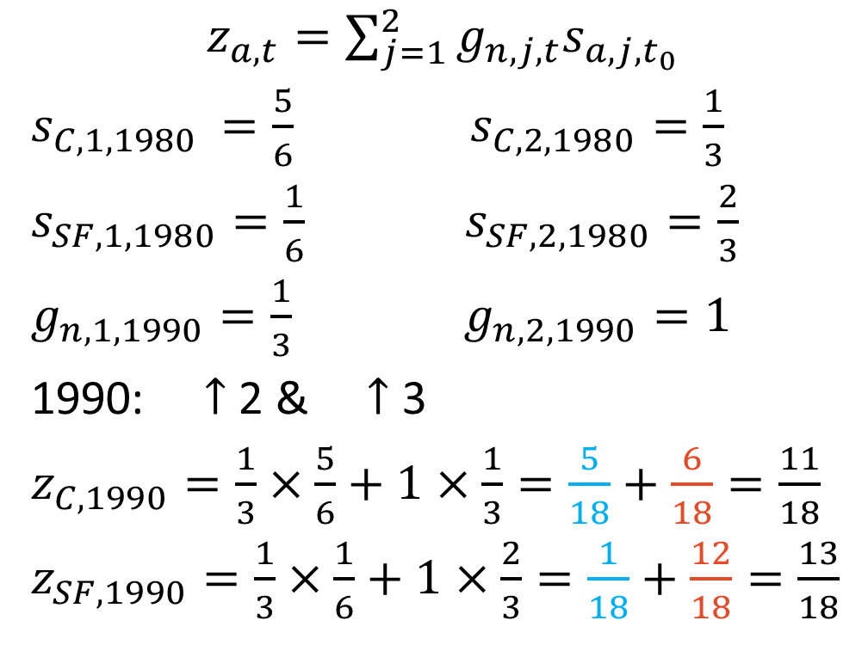
A 2 region $×$ 2 industry example
Chicago Employed at $t_{0}=1980$
San Francisco
$z_{a,t}=\sum_{j=1}^{2}{g_{n,j,t}s_{a,j,t_{0}}}$
$s_{C,1,1980 }=\frac{5}{6}$ $s_{C,2,1980}=\frac{1}{3}$
$s_{SF,1,1980}=\frac{1}{6}$ $s_{SF,2,1980}=\frac{2}{3}$
$g_{n,1,1990}=\frac{1}{3}$ $g_{n,2,1990}=1$
1990: $↑$ 2 & $↑$ 3
$z_{C,1990}=\frac{1}{3}×\frac{5}{6}+1×\frac{1}{3}=\frac{5}{18}+\frac{6}{18}=\frac{11}{18}$
$z_{SF,1990}=\frac{1}{3}×\frac{1}{6}+1×\frac{2}{3}=\frac{1}{18}+\frac{12}{18}=\frac{13}{18}$

Slide 17
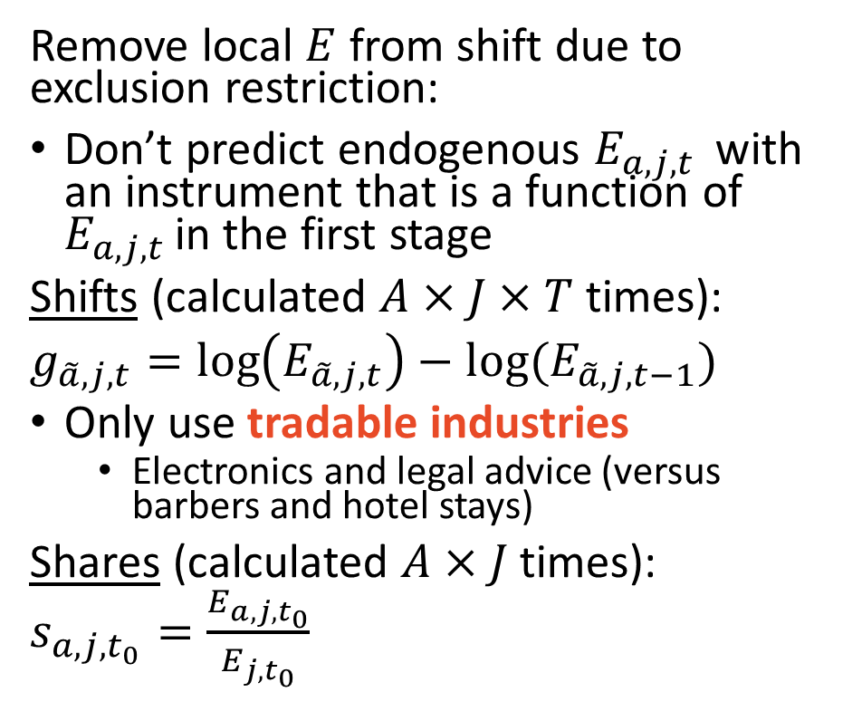
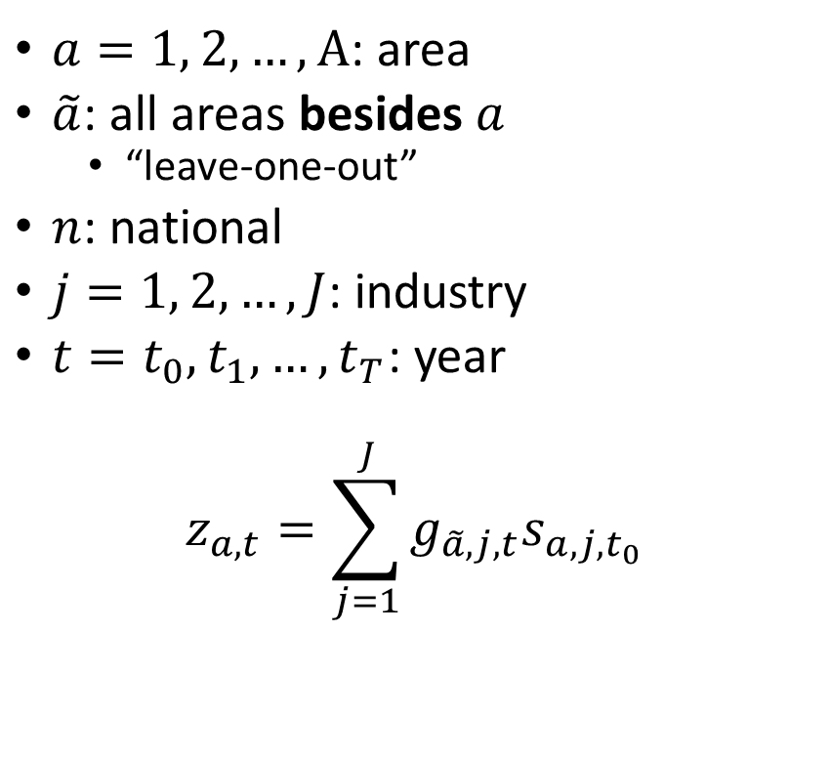
Implementation in practice
$a=1, 2, …, A$: area
$\tilde{a}$: all areas besides $a$
“leave-one-out”
$n$: national
$j=1, 2, …, J$: industry
$t=t_{0}, t_{1}, …, t_{T}$: year
$$z_{a,t}=\sum_{j=1}^{J}{g_{\tilde{a},j,t}s_{a,j,t_{0}}}$$
Remove local $E$ from shift due to exclusion restriction:
Don’t predict endogenous $E_{a,j,t }$ with an instrument that is a function of $E_{a,j,t }$in the first stage
Shifts (calculated $A×J×T$ times):
$g_{\tilde{a},j,t}=\log\left(E_{\tilde{a},j,t}\right)−log⁡(E_{\tilde{a},j,t−1})$
Only use tradable industries
Electronics and legal advice (versus barbers and hotel stays)
Shares (calculated $A×J$ times):
$s_{a,j,t_{0}}=\frac{E_{a,j,t_{0}}}{E_{j,t_{0}}}$

Slide 18
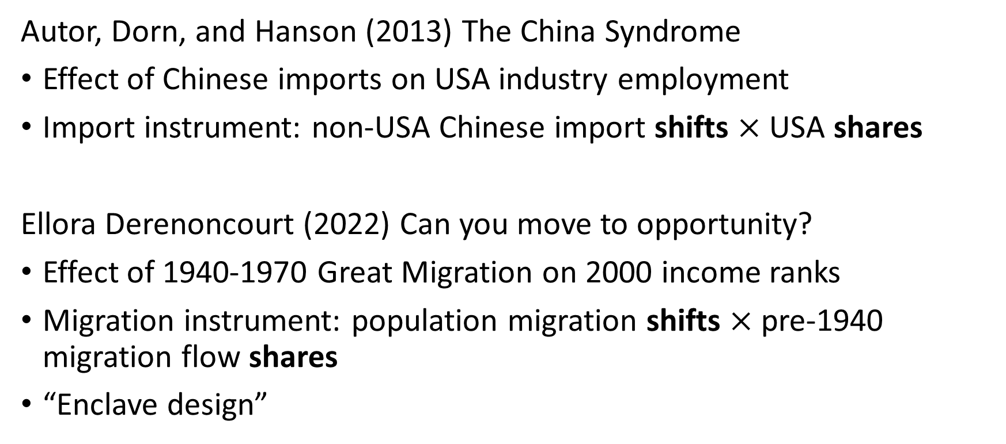
Other applications
Autor, Dorn, and Hanson (2013) The China Syndrome
Effect of Chinese imports on USA industry employment
Import instrument: non-USA Chinese import shifts $×$ USA shares
Ellora Derenoncourt (2022) Can you move to opportunity?
Effect of 1940-1970 Great Migration on 2000 income ranks
Migration instrument: population migration shifts $×$ pre-1940 migration flow shares
“Enclave design”

Slide 19
Coding example & Lab
Constructing shift-shares and feols() practice

Slide 20
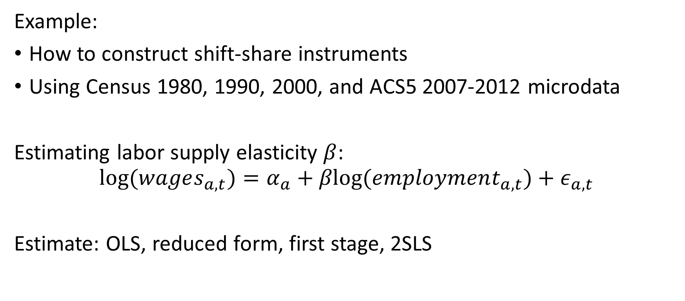
Overview
Example:
How to construct shift-share instruments
Using Census 1980, 1990, 2000, and ACS5 2007-2012 microdata
Estimating labor supply elasticity $β$:
$$log⁡(wages_{a,t})=α_{a}+βlog⁡(employment_{a,t})+ε_{a,t}$$
Estimate: OLS, reduced form, first stage, 2SLS

